Slide 1

PBL Project
MotorVibe
Industrial Motor Condition Monitoring and Health Dashboard
Monitor • Analyze • Prevent Failure
GUIDE
Dr. Karumuri Sri Rama Murthy
Assistant Professor, Department of CSE
KLU Hyderabad
TEAM NO: 1
2520040039 N. Hasini
2520040119 Sameera

Slide 2
Abstract
MotorVibe is a web-based dashboard for monitoring the condition and health of industrial motors.
Physical sensors attached to the motor measure temperature, vibration and electrical current.
A Node.js and Express.js backend receives these readings and checks them against defined limits.
Readings and motor information are stored in a Supabase database.
A React.js frontend shows live values, parameter trend graphs and a Normal, Warning or Critical health status.
Operators can identify abnormal operating conditions early and avoid unexpected breakdowns.
This reduces maintenance cost and improves equipment life.
Planned enhancements include email or SMS alerts, machine learning fault classification and multi-motor monitoring.
Abstract length: 100 words

Slide 3




Technologies Used
FRONTEND
BACKEND / MIDDLEWARE
DATABASE
React.js
Node.js + Express.js
Supabase
Builds the user interface: home page, dashboard, trend graphs and health status.
REST API that receives sensor readings, applies limit checks and serves data to the frontend.
Hosted PostgreSQL database that stores motor information and sensor readings.
Motor data source: physical sensors
Temperature, vibration and current. Sensor models and microcontroller: [to be filled by team]

Slide 4


Problem Description
The problem
Our approach: MotorVibe
Industrial motors run continuously and failures stop production.
Overheating, imbalance, misalignment and bearing wear develop over time.
Periodic manual checks can miss early warning signs.
Unexpected breakdowns raise maintenance cost and shorten equipment life.
Measure temperature, vibration and current using physical sensors.
Check each reading against defined limits in the backend.
Store readings in Supabase for review and trend analysis.
Show live values, trend graphs and a Normal / Warning / Critical status on a web dashboard.

Slide 5
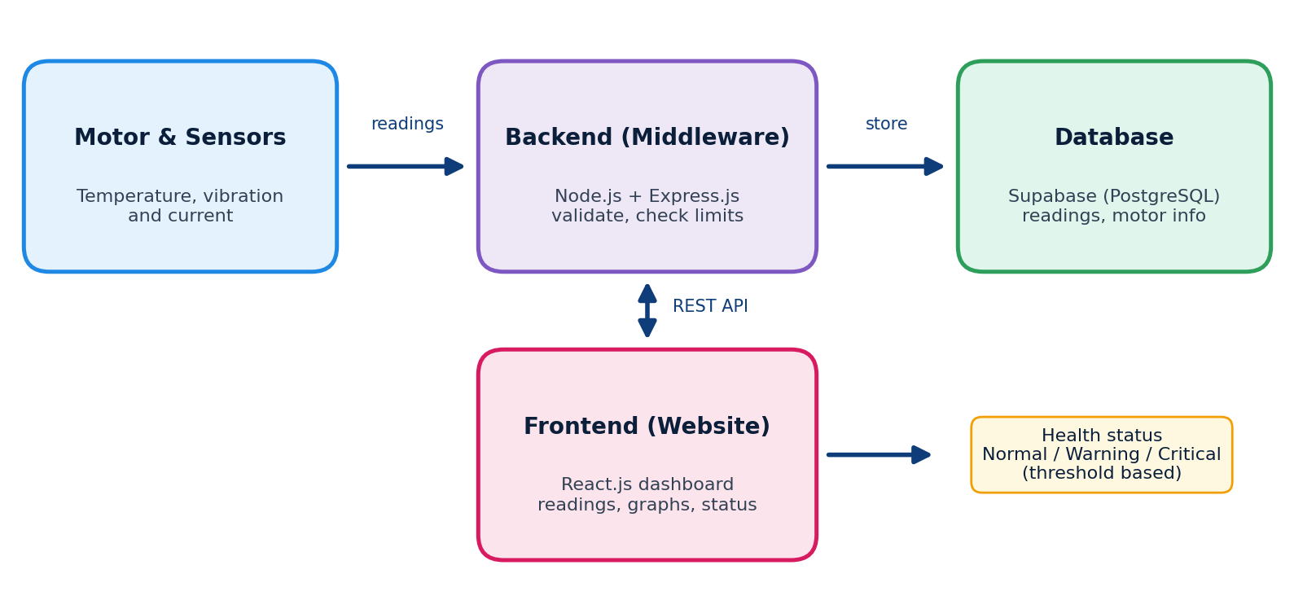
Architecture Diagram
Data flow
Sensors measure motor parameters.
Express API receives and validates readings.
Limits are checked to set the health status.
Readings are stored in Supabase.
React dashboard requests data through the API and displays it.
Sensor-to-backend link (e.g. microcontroller and network method): [to be filled by team]

Slide 6




Implementation Details
1. Sensor acquisition
2. API ingestion
3. Limit checking
4. Storage
5. Visualization
Physical sensors read temperature, vibration and current from the motor.
Node.js + Express.js endpoint receives and validates each reading.
Values are compared with limits to set Normal, Warning or Critical.
Readings and motor details are saved in Supabase.
React.js shows live values, trend graphs and health status.
Website pages
Health status
Home: purpose of the website and link to the dashboard
Dashboard: live readings, health status and parameter trends
About: project information
Normal
Warning
Critical
Limit values: [to be filled by team, e.g. from the motor datasheet]

Slide 7
Output Screens: Home and Dashboard
[Insert screenshot: Home page]
[Insert screenshot: Motor Dashboard with live readings]
Home page. Shows the purpose of the website and quick access to the dashboard.
Dashboard. Displays live sensor readings, motor health and parameter trends.

Slide 8
Output Screens: Graphs and Health Status
[Insert screenshot: Parameter trend graph view]
[Insert screenshot: Motor Health Status panel]
Graph view. Compares temperature, vibration and current over time to spot unusual changes.
Health status. Shows whether the motor is operating normally or needs attention.

Slide 9




Future Enhancements
Historical data
Machine learning
Keep long-term records in Supabase for deeper analysis.
Classify faults automatically from sensor patterns.
Alerts
Multi-motor, remote
Send email or SMS when conditions become critical.
Extend monitoring to many motors and remote locations.

Slide 10
Conclusion
MotorVibe provides a simple and effective way to monitor industrial motor health. It supports early detection of abnormal conditions, helps reduce downtime and maintenance cost, and supports safer, more reliable operations.
Thank you
Team 1: N. Hasini (2520040039), Sameera (2520040119) | Guide: Dr. Karumuri Sri Rama Murthy

